Slide 1
TravelHub
A social platform for sharing and discovering travel experiences.
DD/MM/YYYY
Feature Name/Product
Your Company Name

Slide 2
Introduction
TravelHub is designed to connect travelers, allowing them to create, view, and interact with posts about various destinations.
DD/MM/YYYY
Feature Name/Product
Your Company Name

Slide 3
01
Overview
Upcoming Purpose

Slide 4
Purpose of TravelHub
The primary purpose of TravelHub is to foster a community of travel enthusiasts who can share insights, experiences, and recommendations. It serves as a platform for users to document their journeys and inspire others to explore new destinations.
DD/MM/YYYY
Feature Name/Product
Your Company Name

Slide 5

Target Audience
TravelHub targets a diverse range of users, including solo travelers, families, and adventure seekers. The platform aims to cater to anyone interested in travel experiences, from casual vacationers looking for quick getaway tips to avid explorers seeking in-depth travel narratives.
DD/MM/YYYY
Feature Name/Product
Your Company Name

Slide 6
Technology Stack
TravelHub leverages modern web technologies for a seamless user experience. The backend is powered by Node.js and Express, ensuring efficient handling of user data and interactions. The frontend utilizes React for dynamic user interfaces, allowing real-time updates and a responsive design. Additionally, MongoDB is used as the database solution, providing flexibility and scalability for storing user-generated content.
DD/MM/YYYY
Feature Name/Product
Your Company Name

Slide 7
02
Key Features
Explained

Slide 8

Content Creation and Interaction
Users can create posts detailing their travel experiences, including text, images, and videos. Interaction is encouraged through features like upvoting and commenting, which foster community engagement and facilitate meaningful discussions.
DD/MM/YYYY
Feature Name/Product
Your Company Name

Slide 9
User Engagement Tools
To enhance user engagement, TravelHub includes features like pseudo-authentication for user profiles, allowing users to bookmark favorite posts and follow other travelers. Reposting content is made easy, promoting shareability and the spread of inspiring travel stories.
DD/MM/YYYY
Feature Name/Product
Your Company Name

Slide 10
Customization Options
The platform also allows users to personalize their profiles with interface customization options, including themes and layouts. This ensures that users can create a unique browsing experience tailored to their preferences.
DD/MM/YYYY
Feature Name/Product
Your Company Name

Slide 11
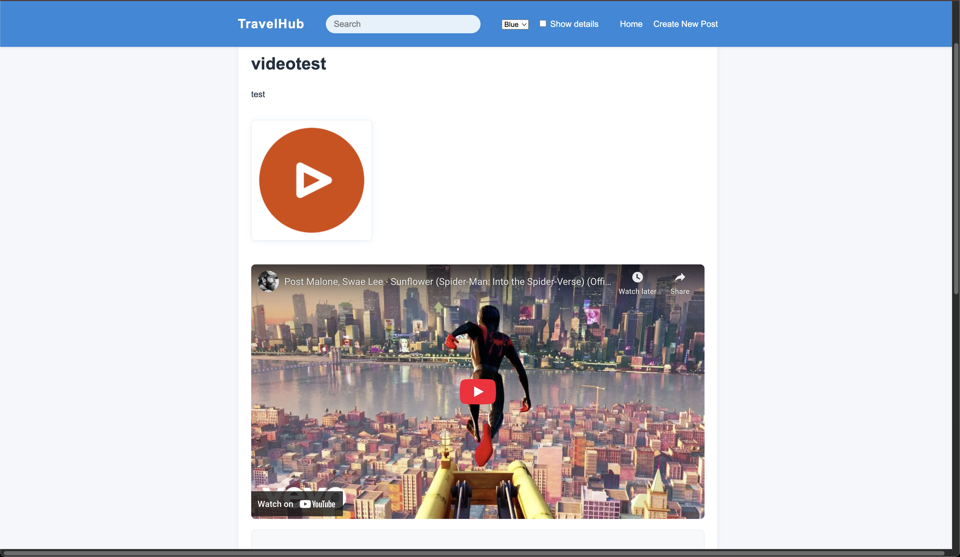
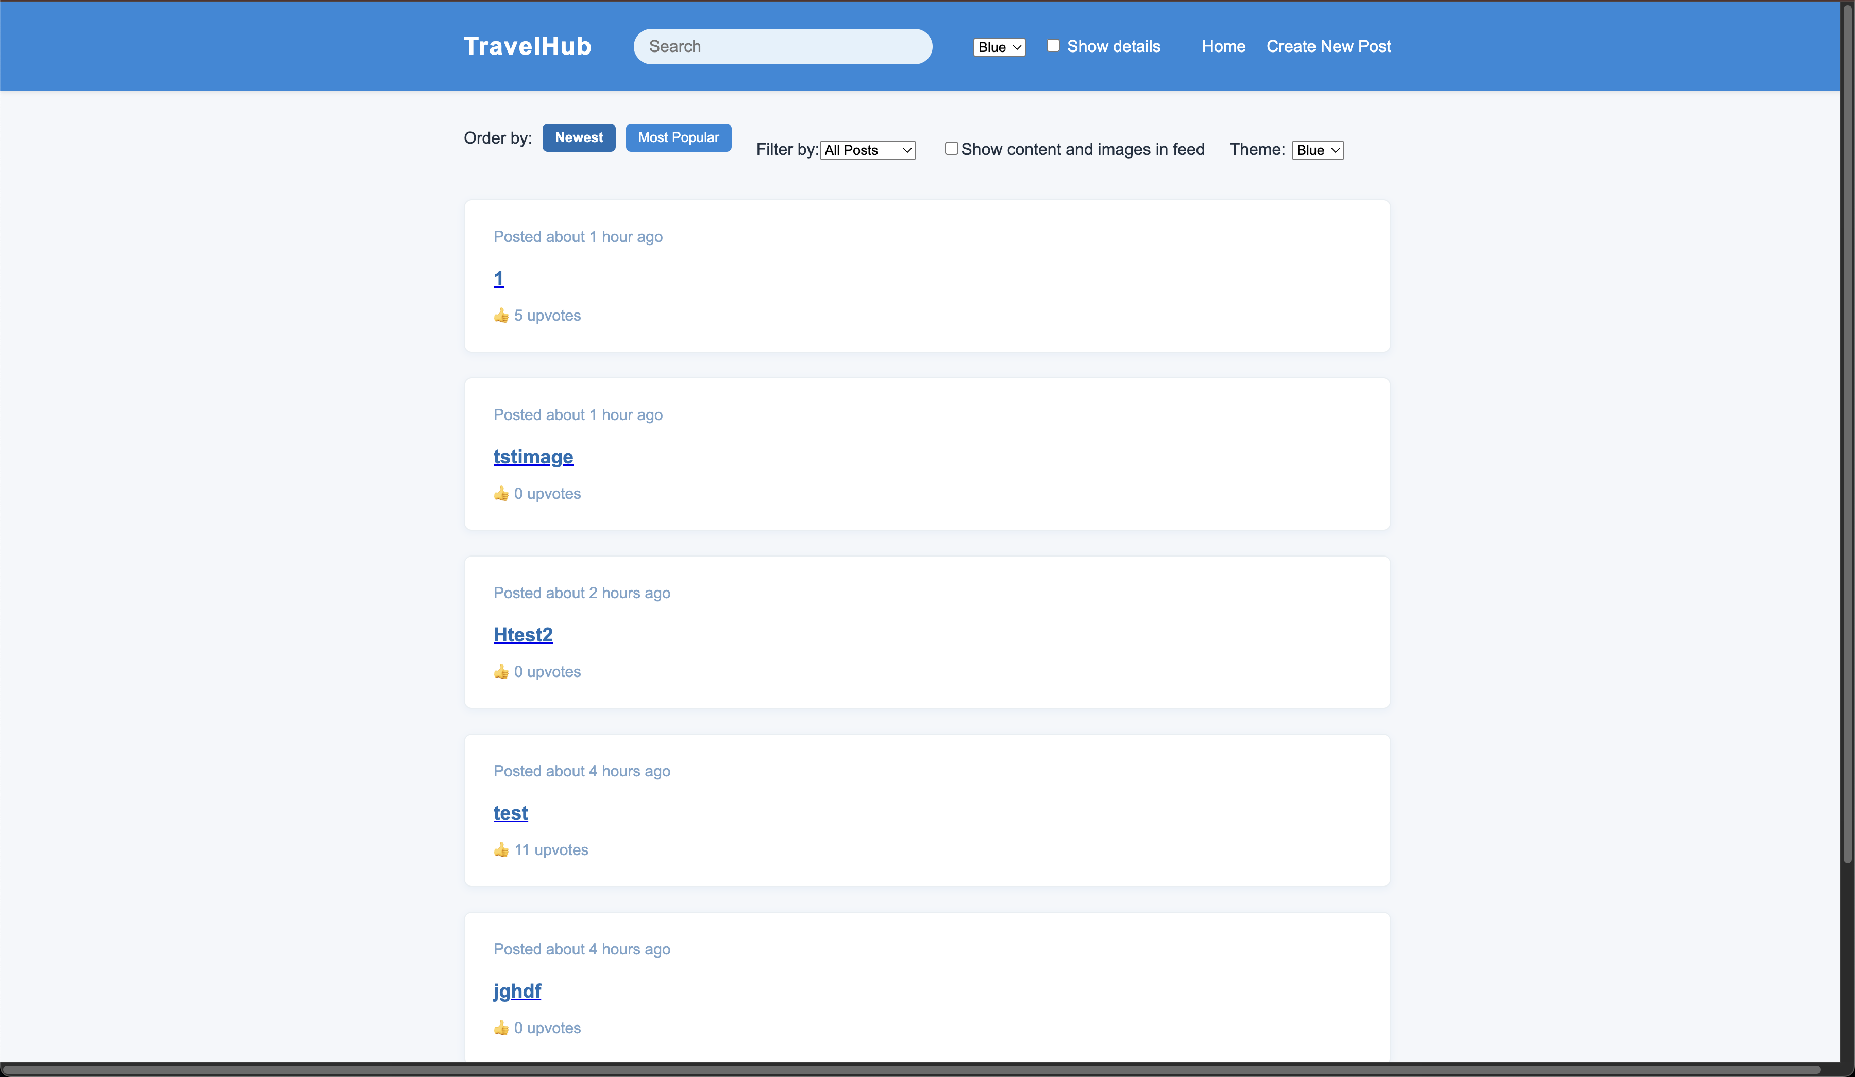
Outcome
Project Link: https://travelhubh.netlify.app/
DD/MM/YYYY
Feature Name/Product
Your Company Name

Slide 12

Conclusions
TravelHub aims to revolutionize the way travelers share experiences by combining modern technology with community-driven features. The platform's design and functionalities cater to the needs of various users, ensuring a valuable resource for anyone seeking travel inspiration.
DD/MM/YYYY
Feature Name/Product
Your Company Name

Slide 13
References
[1] https://supabase.com/
[2] https://vite.dev/
[3] https://react.dev/
[4] https://konstantinmuenster.medium.com/how-to-plan-and-organize-a-react-project-by-building-a-weather-app-95175b11bd01
[5] https://reactjs.org/docs/thinking-in-react.html
[6] https://supabase.com/docs/guides/database/overview
[7] https://reactgo.com/react-load-json-file/

Slide 14
Thank you!
Do you have any questions?
+91 620 421 838
DD/MM/YYYY
www.yourwebsite.com
Your Company Name

